Slide 1
Introduction to Databases
Oumaima Bedhief

Slide 2
MySQL
MySQL is an open-source cross-platform database management system based on SQL queries. Originally it was developed by the Swedish MySQL AB company. Now it is the branch of Oracle Corporation.
The system is conceivably the most popular and recognizable RDBMS worldwide. Such giants as Facebook, YouTube, Uber, Google, and countless other corporations prefer MySQL for their data storing and management. And they have all the reasons to stick to this RDBMS.

Slide 3
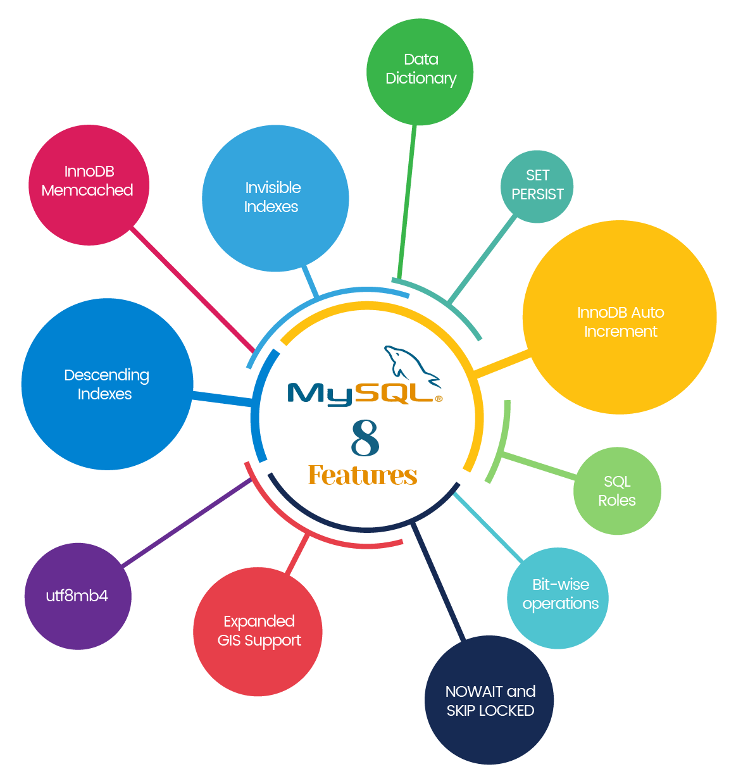

Slide 4
PotgreSQL
PostgreSQL is the world’s most advanced open source database and the fourth most popular database. In development for more than 20 years, PostgreSQL is managed by a well-organized and highly principled and experienced open source community. It is an object-oriented database that is fully ACID compliant and highly extensible, enabling the community to add new features and capabilities as workload demands evolved.

Slide 5
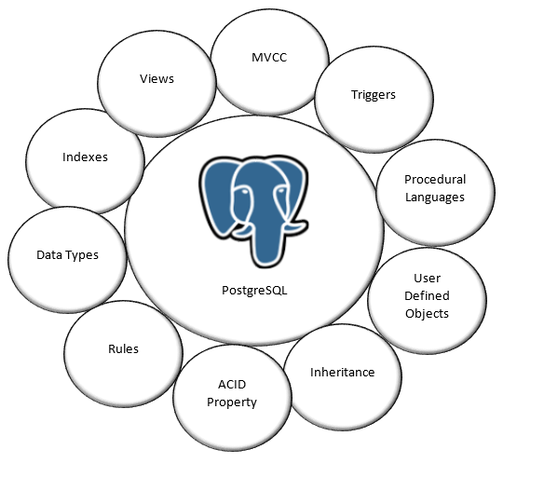

Slide 6
SQL SERVER
SQL Server is a relational database management system, or RDBMS, developed and marketed by Microsoft.
Similar to other RDBMS software, SQL Server is built on top of SQL, a standard programming language for interacting with the relational databases. SQL server is tied to Transact-SQL, or T-SQL, the Microsoft’s implementation of SQL that adds a set of proprietary programming constructs.
SQL Server works exclusively on Windows environment for more than 20 years. In 2016, Microsoft made it available on Linux. SQL Server 2017 became generally available in October 2016 that ran on both Windows and Linux.

Slide 7
SQL Server, PostgreSQL, MySQL... what's the difference?
PostgreSQL and MySQL use very similar syntax, with some notable differences highlighted below. Microsoft SQL Server has the greatest contrast in SQL syntax, as well as a wide variety of functions not available in other platforms. The table below highlights some examples of basic differences between SQL platforms.

Slide 8
